Slide 1


Social Buzz Analysis
Created By:
Joseph Oyeyinka

Slide 2


Today's agenda
Project recap
Problem
The Analytics team
Process
Insights
Summary

Slide 3

Social Buzz is a fast growing technology unicorn that need to adapt quickly to it's global scale. Accenture has begun a 3 month POC focusing on these tasks:
• An audit of Social Buzz's big data practice.
• Recommendations for a successful IPO.
• Analysis to find Social Buzz's top 5 most popular categories of content.
Project Recap

Slide 4

Problem
Over 100000 posts per day
36,500,000 pieces of content per year!
But how to capitalize on it when there is so much?
Analysis to find Social Buzz's top 5 most popular categories of content.

Slide 5



Andrew Fleming
(Chief Technical Architect)
The Analytics team
Marcus Rompton
(Senior Principle)
Joseph Oyeyinka
(Data Analyst)

Slide 6
Process
1
Data Understanding
2
Data Cleaning
3
Data Modelling
4
Data Analysis
5
Uncover Insights

Slide 7

Insights
16
1897
MAY
Reaction to
“ANIMAL” Post
Month with
Most Post
Unique Categories

Slide 8
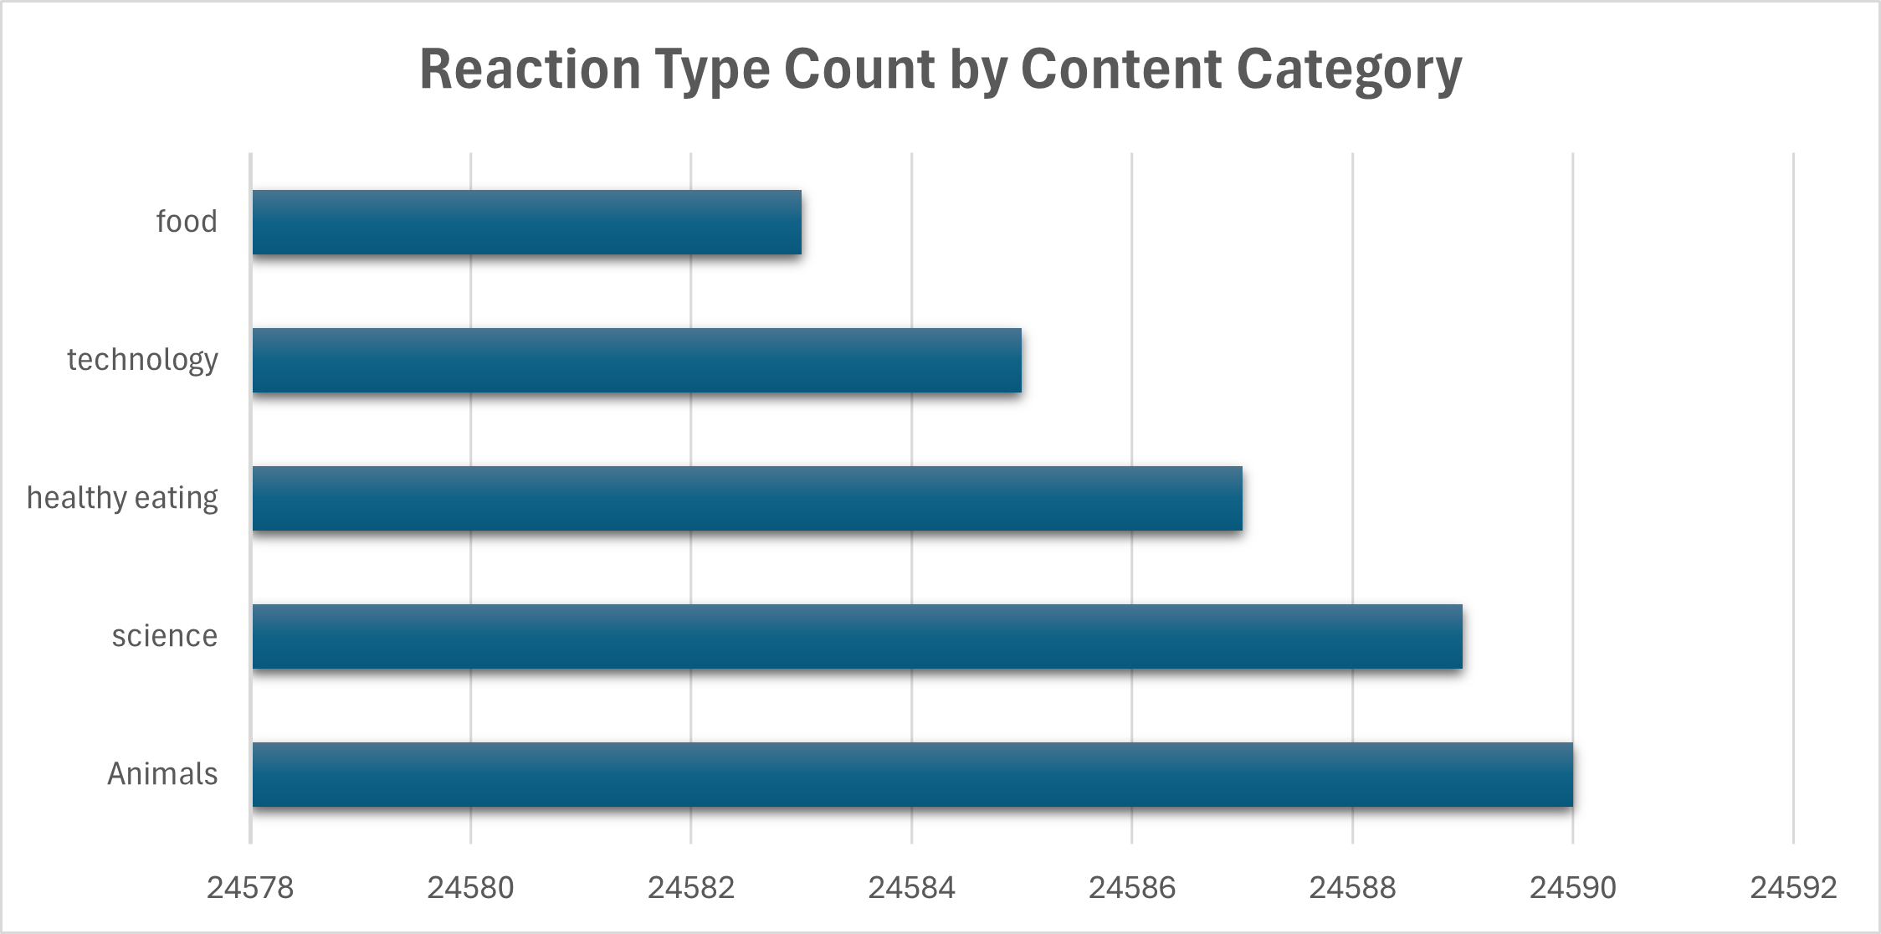
Aggregate Popularity Score

Slide 9
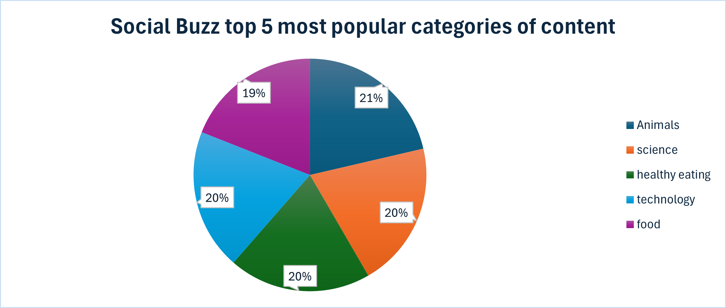

Slide 10

ANALYSIS:
Animals and science are the two most popular categories of content, showing that people enjoy "real-life" and "factual" content the most.
INSIGHT:
Food is a common theme with the top 5 categories with "Healthy Eating" ranking the highest. This may give an indication to the audience within your user base. You could use this insight to create a campaign and work with healthy eating brands to boost user engagement.
NEXT STEPS:
This ad-hoc analysis is insightful, but it's time to take this analysis into large scale production for real-time understanding of your business. We can show you how to do this.
Summary

Slide 11
Thank you!
ANY QUESTIONS?

